Slide 1
NoSQL Databases - Categories
Pravin Y Pawar

Slide 2
NoSQL
Not Only SQL
Coined by Carlo Strozzi in 1998 to name lightweight, open source, relational database that did not expose the standard SQL interface
Johan Oskarsson , in 2009 reintroduced the term to discuss open-source distributed network
Features
Open source
Non-relational
Distributed
Schema-less
Cluster friendly
Born out of 21st century web applications

Slide 3
Categories (1)
Document based
Key-Value stores
Column based or wide column
Graph based
Key-value stores | Column-Oriented | Document based | Graph based
Riak | Cassandra | MongoDB | Neo4J
Redis | Hbase | CouchDB | InfiniteGraph
Membase | HyperTable | RavenDB | AllegroGraph

Slide 4
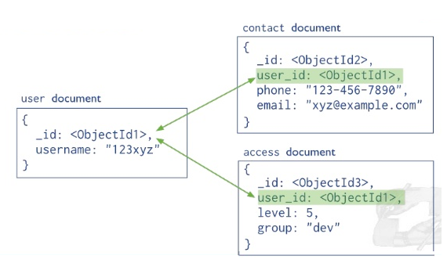
Categories (2)
Document based
Store data in form of documents using well known formats like JSON
Documents accessible via their id, but can be accessed through other index as well
Maintains data in collections of documents
Example,
MongoDB, CouchDB, CouchBase
Book document :
{
“Book Title” : “Database Fundamentals”,
“Publisher” : “My Publisher”,
“Year of Publication” : “2020”
}

Slide 5
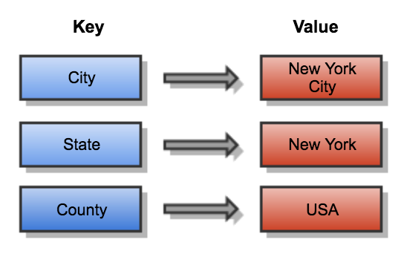
Categories (3)
Key-value stores
Simple data model based on fast access by the key to the value associated with the key
Value can be a record or object or document or even complex data structure
Maintains a big hash table of keys and values
For example,
Dynamo, Redis, Riak
Key | Value
2014HW112220 | { Santosh,Sharma,Pilani}
2018HW123123 | {Eshwar,Pillai,Hyd}

Slide 6
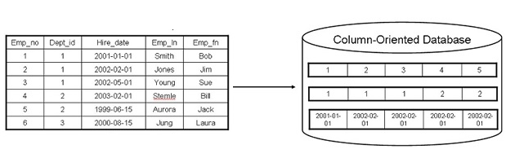
Categories (4)
Column based
Partition a table by column into column families
A part of vertical partitioning where each column family is stored in its own files
Allows versioning of data values
Each storage block has data from only one column
Example,
Cassandra, Hbase

Slide 7
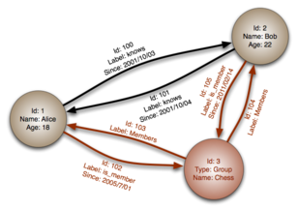
Categories (5)
Graph Based
Data is represented as graphs and related nodes can be found by traversing the edges using the path expression
aka network database
Example
Neo4J,HyperGraphDB

Slide 8
Thank You!
In our next session: Document based NoSQL Databases

